Slide 1
Webinar: New Konnect
22 August 2023

Slide 2
Agenda
Introduction to the new Konnect
The new Konnect Framework file
Example of migrating existing reporting to the new Konnect

Slide 3
Introduction: Why a new Konnect?
The mission: To deliver a high performing futureproof API with additional information available as requested by the users
No alternative as performance ultimately would have effected everybody
Necessary to introduce breaking changes so we can’t do a seamless upgrade
The benefits:
Improved performance: With the rebuilt Konnect, you can pull data much more quickly.
  Konnect has been rebuilt from the ground up with a brand new architecture
  Industry-standard fair use policies including limitation per server call via mandatory filters
Availability of additional information: You will have additional information available for your reporting and streamlined field names across the tables. Some information ready now and so preparations have been done for the future.

Slide 4
Introduction: The major changes
“Combined” Consolidated Accounts table:
All sources (Actual, Budget, Forecast etc.) in one table
Local account information in Uploaded Accounts table:
As requested by many the details of the initial upload are now available
Same presentation principle:
All financial figures are now in debit/credit in Konnect
Streamlined field names:
All field names across available tables are now subject to the same naming standard

Slide 5
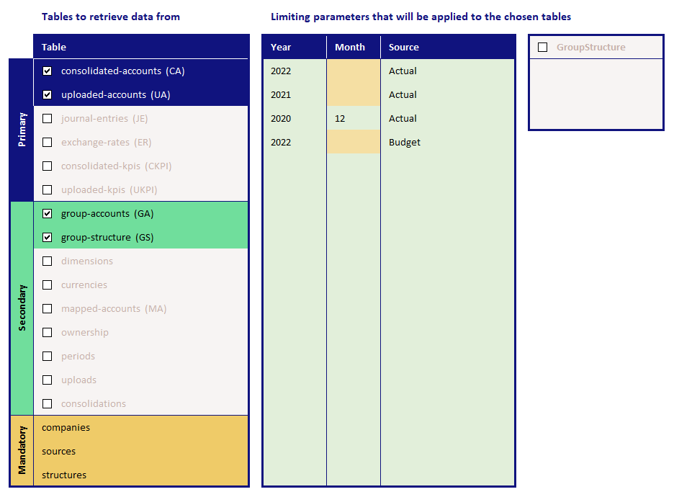
Introduction: The new Konnect Framework file

Slide 6
Example: Best practices
Always move existing reporting to the framework file
  Only copy the output sheets (and any supporting sheets with connection to the old Konnect)
  Make sure to copy all relevant sheets at the same time to keep references between the sheets you need to move
  Make sure you don’t move – select copy
  Leave the old report open
Use search and replace
  Check the report for the different formulas used and replace accordingly
  Do one sheet at a time
  Use the “Edit links” option on the Excel data band as a check to see if you missed a reference
  Use the Excel search feature to find anything missed – search for the filename of the old report file

